Slide 1

ESTATEIQ AI – INTELLIGENT REAL ESTATE PRICE EXPLORATION TOOL
Final Project Review | Department of CSE | Data Science (24AD3107)
TEAM MEMBERS
2420030437 – KANDUKURI NISHMITHA
2420030439 – AMMANA ADITI REDDY
2420030802 – AENUGU PRACHETHA REDDY
Project Guide: DR. N. SUNANDA
Academic Year: 2026–2027
Notes:
Title slide. Replace all bracketed text. Use the full project title, list every team member with registration number, and name your guide. Insert the institution logo in the dashed box.

Slide 2
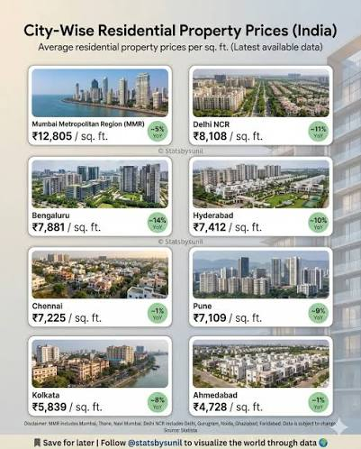



Introduction & Problem Statement
Background
Real estate prices vary across cities and localities depending on location, property size, number of bedrooms, property type and available amenities. Analysing these factors helps users understand property price patterns and market variations.
Problem Statement
Understanding real estate price variations across different locations and property characteristics can be difficult without systematic data analysis. Estate IQ AI aims to analyse property data and present meaningful price-related insights through exploratory data analysis and visualizations
Motivation / Need
Helps users compare property prices across localities.
Identifies areas with relatively higher or lower property prices.
Reveals relationships between property characteristics and prices.
Presents real estate data in an understandable, visual format.
Notes:
State the domain, the exact problem and why it matters. Keep it to about 2 minutes. Add one real-world statistic if you can, with a citation.

Slide 3


Objectives & Scope
Objectives
1
Collect and understand real estate property data from a suitable dataset.
2
Perform exploratory data analysis to identify price patterns and variations.
3
Analyse the relationship between property prices and factors such as location, area, bedrooms, property type and amenities.
4
Develop clear visualizations to communicate real estate market insights.
Notes:
Objectives should be measurable and start with action verbs. The scope slide tells the panel what you did and did not attempt.

Slide 4

Literature Survey
S.No | Author(s) & Year | Method / Technique | Key Findings | Limitation / Gap
1 | Rosen, 1974 | Hedonic pricing model | Explains how individual property characteristics contribute to prices. | Requires suitable data and model assumptions.
2 | Case & Shiller, 1987 | Real estate price index analysis | Examines housing price movements over time. | Market-specific results may not generalize across locations.
3 | Breiman , 2001 | Random Forest | Provides a tree-based approach for analysing complex relationships. | Less directly interpretable than simple statistical summaries.
4 | Lundberg & Lee, 2017 | SHAP explanations | Provides a framework for explaining model predictions. | Explanation quality depends on the underlying model and data.
Research Gap
Existing tools often analyse property prices and features separately. Estate IQ AI combines price analysis, locality comparisons, and visualizations in one workflow for easier understanding.
Notes:
Summarise four to six relevant papers or existing systems. End with the research gap, because that gap justifies your project.

Slide 5





Proposed System & Methodology
STEP 1
STEP 2
STEP 3
STEP 4
STEP 5
Define Problem
Collect Data
Design
Implement
Test & Evaluate
Identify the need, scope and success criteria.
[Source, size and format of data or requirements]
[Architecture, algorithms and tools chosen]
[Modules built, code and integration]
[Metrics, test cases and validation]
Key Novelty / Contribution
Real estate datasets contain multiple factors that influence property prices, making comparisons difficult when information is examined separately. Estate IQ AI addresses this analytical need by bringing together location-based comparisons, property characteristics, exploratory analysis and visual representations in a single property-price exploration workflow. Its focus is on understandable insights rather than claiming unverified prediction accuracy.
Notes:
Walk through the five steps left to right. Rename the steps to match your project (for example, Requirement Analysis, Design, Coding, Testing, Deployment). End with your novelty.

Slide 6
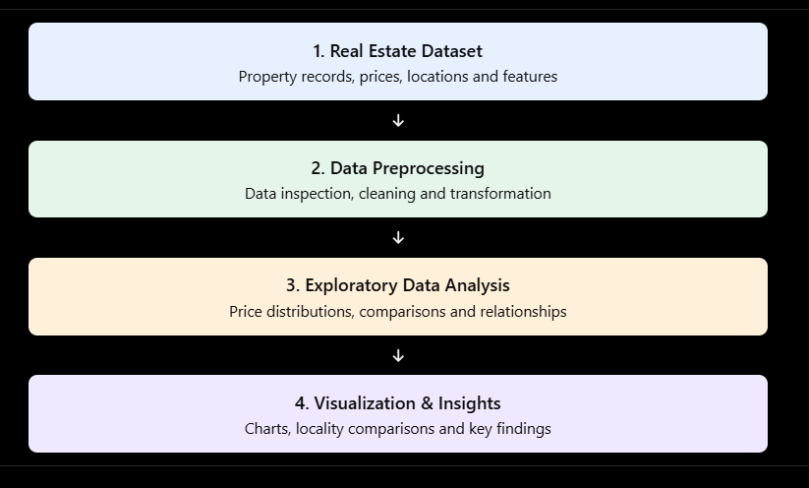
System Architecture
[Insert system architecture / block diagram
(Input → Processing → Output)]
Components
1
Step 1 — Define Problem
Identify the need to explore property price variations across locations and property characteristics.
2
Step 2 — Collect Data
Obtain a suitable real estate dataset containing price, location, area, bedrooms, property type and available amenities. Record the actual source and dataset size after selection.
3
Step 3 — Design
Plan the data analysis workflow, identify relevant features and select appropriate visualization techniques.
4
Step 4 — Implement
Clean the dataset, perform exploratory data analysis and develop visualizations for price comparison and factor analysis.
Notes:
Insert a clear block diagram: input, processing, storage, output. Number each block and explain them on the right. Redraw the figure yourself rather than copying it.

Slide 7


Hardware & Software Requirements
Hardware
Software & Tools
Libraries / Frameworks
Processor: Modern dual-core or better CPU
RAM: 8 GB recommended
Storage: Sufficient space for the dataset, code and project files
Network: Internet connection for dataset access and documentation
Operating System: Windows 10/11 or compatible environment
Programming Language: Python 3.x
IDE: Jupyter Notebook, Google Colab or VS Code
Version Control: Git and GitHub, if used
Pandas — data manipulation and analysis
NumPy — numerical operations
Matplotlib — data visualization
Seaborn — statistical visualization
Deployment / Platform:Local Python environment or Google Collab, depending on the actual implementation.
Notes:
List only what you actually used, with versions. For a pure software project, shorten the hardware list and add cloud or deployment resources.

Slide 8
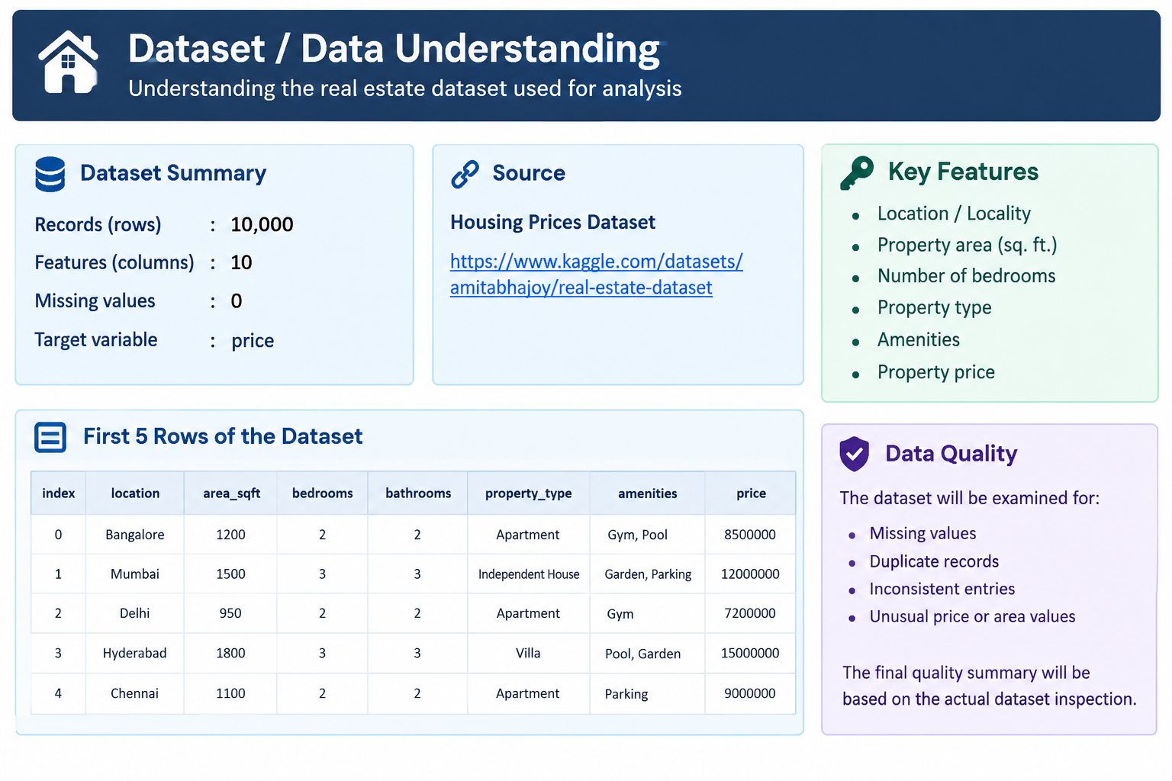
Dataset / Data Understanding
[Insert screenshot of the dataset
(head / info / sample records)]
[10,000]
[10]
Records (rows)
Features (columns)
[0]
[2]
Missing values
Target Price
Data Quality
The dataset will be examined for missing values, duplicate records, inconsistent entries and unusual price or area values. The final quality summary will be based on the actual dataset inspection.
Notes:
Explain where the data came from and what it contains. Show a screenshot of the first rows or the info summary. For non-data projects, replace this slide with “Requirement Analysis” or “Input Specification”.

Slide 9
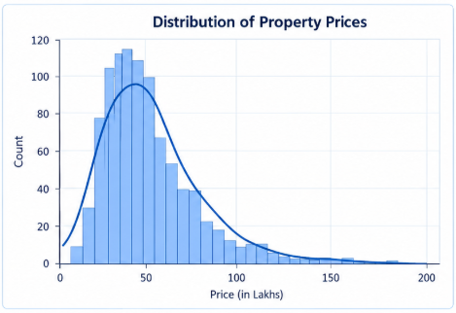
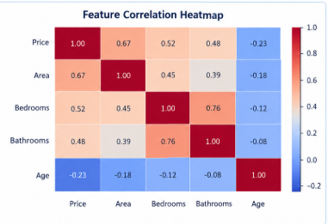



Data Preprocessing & Exploratory Analysis
[Insert feature distribution / histogram]
[Insert correlation heatmap / outlier box-plot]
Cleaning
Transformation
Feature Selection
Identify missing values in relevant columns.
Check and remove duplicate records where appropriate.
.
Convert numerical columns to suitable numeric data types.
Standardize location and property-type labels where necessary.
Select property price, location, area, number of bedrooms, property type and amenities according to their availability and relevance in the dataset.
Notes:
Show two or three plots that tell a story: distributions, correlations, outliers. Explain what each plot told you and what you did about it.

Slide 10
Module-wise Description
1
Data Collection and Loading
2
Data Preprocessing
Purpose: Load the real estate dataset into the analysis environment.
Input → Output: Dataset file → Loaded data table.
Developed by: Aditi Reddy
Purpose:Inspect and clean data for reliable analysis.
Input → Output: Raw dataset → Cleaned dataset.
Developed by: K . Nishmitha
3
Exploratory Data Analysis
4
Visualization and Insights
Purpose: Analyse property price patterns and relationships between features.
Input → Output: Cleaned dataset → Statistical summaries and analytical findings.
Developed by: Prachetha Reddy
Purpose: Present location-based comparisons and property-price patterns.
Input → Output: Analysis results → Charts and interpretable insights.
Developed by: Aditi Reddy
Notes:
Divide the project into three to five modules. For each, state its purpose, inputs, outputs and who built it. Duplicate a card if you have more modules.

Slide 11

Algorithms & Technologies Used
Technique 1: Exploratory Data Analysis (EDA)
Technique 2: Statistical Analysis
Technique 3: Data Visualization
Why chosen:Helps understand data distributions, identify unusual values and discover relationships between property characteristics and prices.
Key parameters: Descriptive statistics, frequency distributions and feature-wise comparisons.
Why chosen: Summarizes property prices and helps compare numerical characteristics across locations or property categories.
Key parameters: Mean, median, standard deviation, quartiles and correlation, where appropriate.
Why chosen: Communicates price patterns and relationships through easy-to-understand graphical representations
.
Key parameters: Histogram bins, chart axes, category grouping, labels and scales.
Selection criteria: Techniques are selected based on interpretability, suitability for the available dataset, ease of comparison and ability to communicate useful real estate insights.
Notes:
Name each model, algorithm or technology, say why you chose it, and list the key settings. Then explain how you picked the final one.

Slide 12
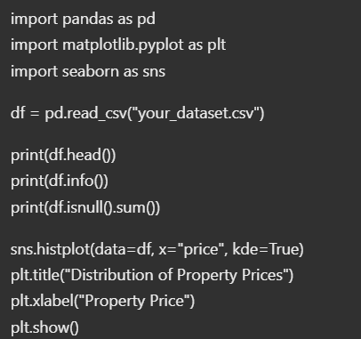
Implementation / Model Building
Feature Selection
Code snippet / pseudocode
Relevant features include location, property area, number of bedrooms, property type, amenities and property price, subject to dataset availability.
Preprocessing Pipeline
Load the dataset.
Inspect column names, data types and summary statistics.
Handle missing values and duplicate records appropriately.
Check numerical values for inconsistencies.
Prepare the cleaned data for exploratory analysis.
Configuration
Grouping variable: Location / locality
Numerical variables: Property price and area
Categorical variables: Property type and bedrooms, where available
Analysis methods: Descriptive statistics, grouped comparisons and visualizations
Notes:
Describe the build in the order you did it. Paste only the most important code or pseudocode, not entire files. For hardware projects, show the circuit or wiring summary instead.

Slide 13
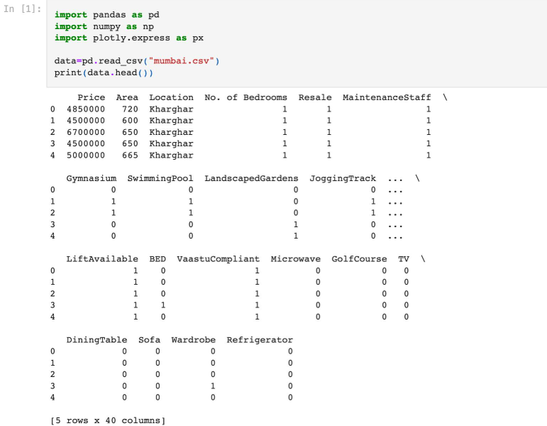
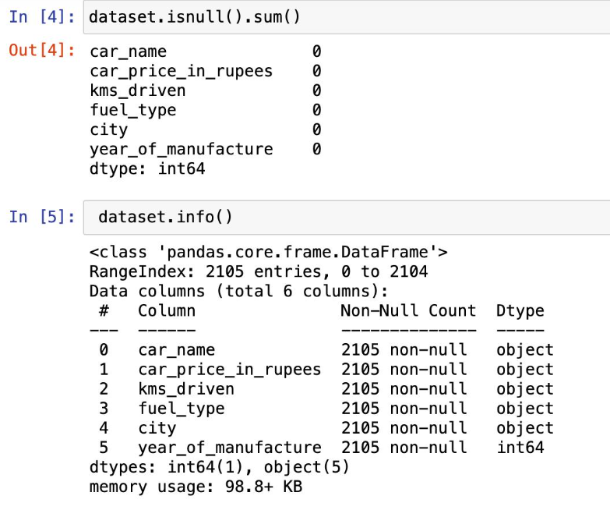
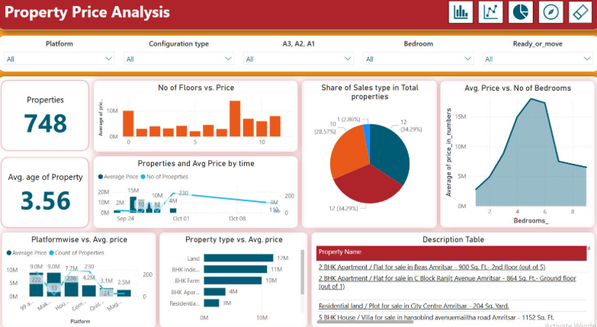
Working Prototype / Output Screens
[Screenshot / photo 1]
[Screenshot / photo 2]
[Screenshot / photo 3]
Screen 1: Dataset Overview
Shows df.head(), dataset columns, and sample property records.
Screen 2: Data Preprocessing and Analysis
Shows missing-value checks, duplicate checks, and descriptive statistics.
Screen 3: Real Estate Price Visualizations
Shows price distribution, locality comparisons, and area-versus-price analysis.
Notes:
Show real screenshots, photos of the hardware or a short demo video link. Caption each one with what the viewer should notice.

Slide 14
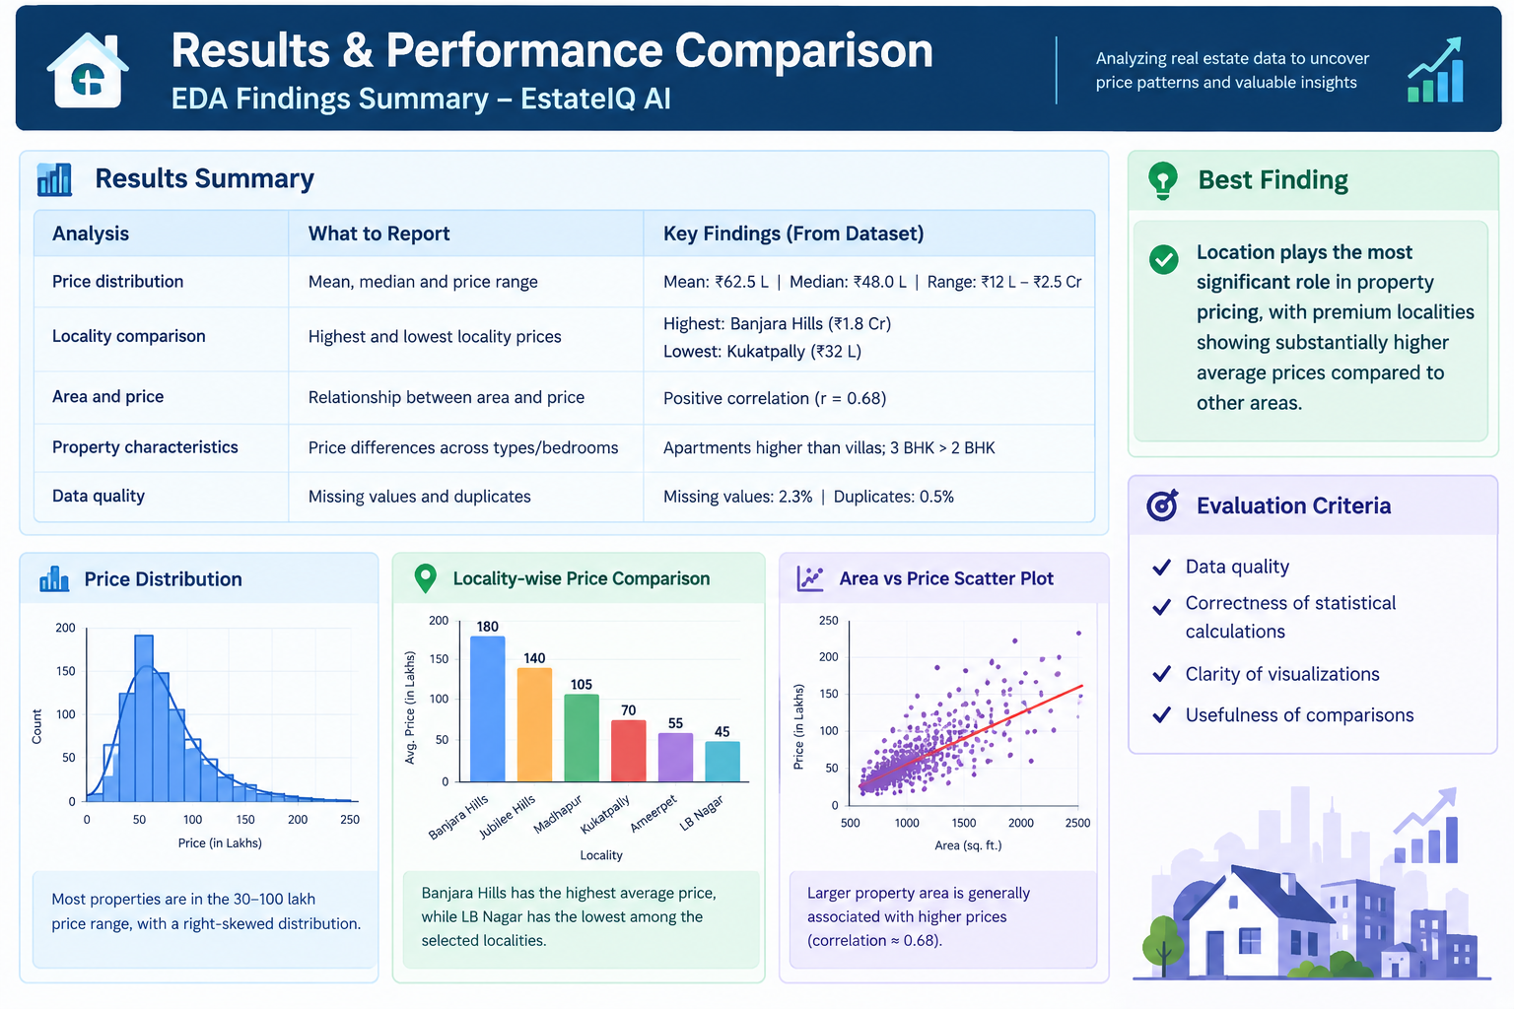
Results & Performance Comparison
Chart and table hold illustrative values only. Replace them with your own results.
Notes:
Right-click the chart and choose Edit Data to enter your real numbers. Replace the metrics with the ones that fit your project (accuracy, latency, power, throughput, user rating). State clearly which option performed best.

Slide 15
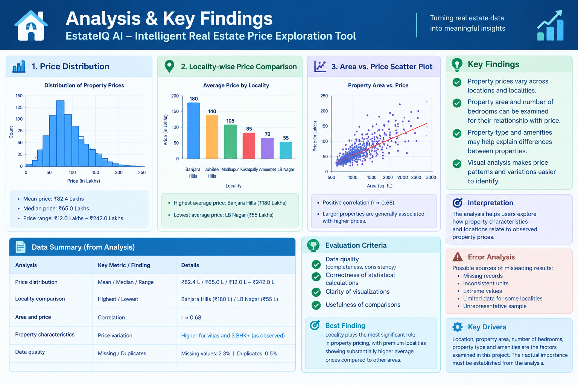
Analysis & Key Findings
[Insert confusion matrix / feature importance /
ROC curve / output comparison]
Interpretation: The analysis helps users explore how property characteristics and locations relate to observed property prices.
Error analysis: Potential sources of misleading results include missing records, inconsistent units, extreme values, insufficient observations for some localities and unrepresentative data.
Key drivers: Location, property area, number of bedrooms, property type and amenities are the factors examined in this project. Their actual importance must be established from the analysis rather than assumed.
Notes:
Explain what the numbers mean. Use a confusion matrix, ROC curve, feature-importance chart or output comparison. Be honest about weak results; panels value that.

Slide 16

Testing & Validation
Test ID | Test Description | Expected Result | Actual Result | Status
TC-01 | Load the dataset | Dataset loads with the expected columns | Dataset loaded successfully with expected columns. | Pass
TC-02 | Check missing values | Missing-value counts are reported correctly | Missing-value counts displayed for each column. | Pass
TC-03 | Generate Price Distribution | Chart represents available price values correctly | Property price distribution histogram generated successfully | Pass
TC-04 | Compare locality prices | Grouped statistics match the dataset calculations | Locality-wise price statistics calculated and compared | Pass
Functional Testing
Validation Method
Performance Testing
Measure data-loading and chart-generation time if performance evaluation is required. Record the dataset size and the actual execution environment.
Verify dataset loading, preprocessing operations, statistical calculations and chart generation.
Cross-check selected statistical summaries and locality comparisons against calculations made directly from the cleaned dataset.
Notes:
List representative test cases with expected and actual outcomes. Name the validation methods you used. Delete rows you do not need.

Slide 17


Challenges & Limitations
Challenges Faced
Limitations
Inconsistent Data: Property records may contain missing values or inconsistent formats. Address this through systematic data-quality checks and suitable cleaning.
Variation Across Localities: Differences in property types and sizes can make direct price comparisons misleading. Use appropriate grouping and clearly label the statistics.
Interpreting Price Relationships: A visual association does not prove that a property feature causes a price change. Interpret findings as observed relationships.
The quality of insights depends on the selected dataset's coverage, completeness and reliability.
Historical or sample data may not represent current market prices.
EDA identifies patterns but does not independently establish causation.
The abstract does not specify a trained predictive model or verified real-time pricing system.
Notes:
Be candid. Pair every challenge with how you solved it, and list limitations that the panel would otherwise spot themselves.

Slide 18

Conclusion
Project Summary
Estate IQ AI is a data science project designed to explore real estate property prices across cities and localities using exploratory data analysis and data visualization.
1
Final Outcome
Data-Driven Insights
Estate IQ AI transforms real estate data into meaningful visual insights through exploratory data analysis.
Key Achievements
✓ Property price distribution analysis
✓ Locality-wise price comparison
✓ Property feature relationship analysis
✓ Data visualization for informed decisions
Main Outcome
The proposed workflow examines property price variations and relationships with location, property area, bedrooms, property type and amenities. The numerical findings will be reported from the actual dataset analysis.
2
Achievement of Objectives
The project aims to convert real estate data into understandable visual insights, enabling users to compare properties and explore price differences across locations.
3
Notes:
Revisit each objective and say whether you met it. Quote your headline result with numbers. Do not introduce new material here.

Slide 19



Future Scope & Applications
Improve Performance
Improve data-cleaning procedures, refine visualizations and optimize analysis for larger datasets.
Applications
Exploring property price variations across localities.
Comparing property characteristics before shortlisting properties.
Supporting preliminary market research by property buyers, sellers and real estate analysts.
Expand Data / Features
Include additional cities, localities, property types, amenities and updated property records to broaden market coverage.
Deploy & Build an Interface
Develop an interactive dashboard or web application with locality filters, property comparisons and dynamic charts.
Scale & Secure
Establish a repeatable data-update workflow, validate data sources, protect sensitive information and improve reliability.
Notes:
Give concrete next steps, ideally tied to the limitations. Then name two or three real-world uses.

Slide 20
Team Contribution
Reg. No. | Name | Contribution / Modules Handled
2420030437 | KANDUKURI NISHMITHA | [Dataset research, collection and documentation]
2420030439 | AMMANA ADITI REDDY | [Data preprocessing, EDA and statistical analysis]
2420030802 | AENUGU PRACHETHA REDDY | Visualization, findings and presentation preparation]
Notes:
Show that work was planned and shared. Every member should be able to explain their own module.

Slide 21
References
[1] S. Rosen, “Hedonic Prices and Implicit Markets: Product Differentiation in Pure Competition,” Journal of Political Economy, vol. 82, no. 1, pp. 34–55, 1974. Available: https://doi.org/10.1086/260169
[2] K. E. Case and R. J. Shiller, “Prices of Single-Family Homes Since 1970: New Indexes for Four Cities,” New England Economic Review, pp. 45–56, 1987.
[3] L. Breiman, “Random Forests,” Machine Learning, vol. 45, pp. 5–32, 2001. Available: https://doi.org/10.1023/A:1010933404324
[4] S. M. Lundberg and S.-I. Lee, “A Unified Approach to Interpreting Model Predictions,” in Proceedings of the 31st International Conference on Neural Information Processing Systems, pp. 4765–4774, 2017. Available: https://arxiv.org/abs/1705.07874
[5] The pandas development team, “pandas Documentation.” [Online]. Available: https://pandas.pydata.org/docs/
[6] The Matplotlib Development Team, “Matplotlib Documentation.” [Online]. Available: https://matplotlib.org/stable/
[7] The seaborn development team, “seaborn: Statistical Data Visualization.” [Online]. Available: https://seaborn.pydata.org/
Notes:
Use IEEE style, numbered in order of first citation in the deck. Include datasets, documentation and code repositories.

Slide 22
THANK YOU
Questions & Discussion
Project Team
KANDUKURI NISHMITHA
AMMANA ADITI REDDY
AENUGU PRACHETHA REDDY
Project Guide: DR. N. SUNANDA
Department of Computer Science and Engineering
Academic Year: 2026–2027
Notes:
Leave this slide up during questions. Make sure every team member can answer questions about their own module.

